Slide 1
January 29th
Reading as a Writer

Slide 2
Quote of the Day
“As far as anyone knew, the laws as they existed then would stand forever. They were meant to—and did—create a world that fixed black people at the bottom of society in all aspects of human life” (Mebane 158).

Slide 3
Today’s Agenda
QOTD
Opening Question
Introduction to Reflective Essay
What is a narrative?
How do we read?
What questions can we ask about our readings?
How do we discuss readings?

Slide 4
What is one cause/issue in today’s global society that is important to you?

Slide 5
Reflective Essay (15% of your final grade)

Slide 6
SUBMITPROFMORABITO@GMAIL.COM

Slide 7
What is a narrative?
A narrative tells a story, but a story with a purpose
Some important parts of a narrative: plot, narrator, point of view setting, dialogue
When writing a narrative, start with a subject/topic, then think of purpose and audience, then think of details/plot
Narratives tend to have transition words
For this narrative, you also want to think about the takeaway/bigger picture

Slide 8
What do you do when you are assigned a reading for class?

Slide 9
What to look for when you read
Read the description before the article to get some context
What does the title make you think of?
1st reading: skim for plot
2nd reading: point/thesis, purpose, audience, tone, supporting details, writing style
After reading: can you summarize the text, can you answer the questions, what is your takeaway from the text?

Slide 10
Modeling Reading at Home

Slide 11
What kinds of (discussion questions) can we ask about our readings?
Discussion questions must be open ended.
The answers should require thought.
You should not be able to find a direct answer in the text, but you should use the text as the basis of your questions
Discussion questions may also place the reading into the context of something else, such as current or historical events

Slide 12
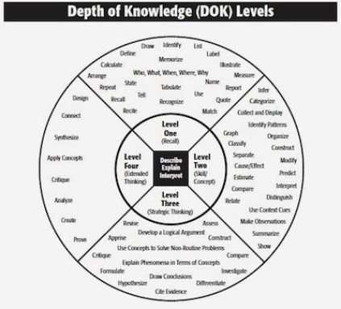

Slide 13
Let’s compare some questions
What does Mebane state is unique about the generation she is born into?
What was it like for Mebane growing up?

Slide 14
Let’s compare some questions (cont’d)
Why is Mebane’s experience on the bus significant?
What happens when Mebane is on the bus?

Slide 15
3 discussion questions
What kinds of detail does Mebane use in her narrative? How does this contribute to her overall narrative?
Why does Mebane continually refer to the speed of the bus?
Why do you think Mebane chose to close this chapter of her book with the line “The people who devised this system thought that it was going to last forever” (164)? What do you think Mebane was trying to say here?

